Slide 1
WEEK SIX
Design Models
This week’s lecture aims cover the following:
Definition
Objectives
Design concerns
Database Design
Architecture Design
Component-based Design
UML Component diagram
Class Examples/Discussions

Slide 2
Software Design Phase
Definition
This is the phase where we think about, and state “HOW” the problem may be best solved
The IEEE Standard Glossary of Software Engineering Terminology (IEEE Std 610.12-1990) defines software design as "the process of defining the architecture, components, interfaces, and other characteristics of a system or component" and "the result of [that] process".
Software design is both a process and a model.

Slide 3
Software Design Phase
Objectives
The primary aim of the design phase is to establish the architecture with which the software system to be developed will run.
The objectives are to highlight:
how the system or program should meet the customer’s needs
how to make system effective, efficient, and secure.
the tools to be used
Deliverables such as the following are produced:
The Architecture Document
Database design
Implementation Plan
Performance Analysis

Slide 4
Software Design Phase
Design Concerns
SECURITY
Interfaces and/or proxies must be securely managed and protected from illegal access.
MODULARITY
Isolating the various ‘layers’ that make up the overall aarchitecture, so that changes in one layer affects other layers minimally
RE-USE
Component that have been used and have proven successful, can be used again in subsequent closely related project functionality

Slide 5
Software Design Phase
Design Activities
Input: product of the requirements elicitation and analysis phase.
Mapping Requirements to an Architecture
Think in term of high level “concepts”.
(E.g. what components will be performing what tasks? Where will the component be located?)
Design must be clear and easy to understand
A design can be object-oriented or function-oriented

Slide 6
Software Design Phase
Design Activities
The design phase involves the creation of:
Software Architecture
Detailed Design
In other words, Design is usually broken down into:
high-level, architecture design.
low-level component and algorithm design
identification of various system components, and their interactions
detailed description of these components

Slide 7
Software Design Phase
Design Activities
Design activities involve:
Gross decomposition of required function
Assignment of function to elements
Identification of elements, and their interaction
Emergent system properties
E.g. performance capabilities, load balancing, security
Consideration of design alternatives, for eventual selection
Which elements will achieve the aim best?

Slide 8
Software Design Phase
Requirements Engineering & Architecture Design
Requirements Engineering and Architecture Design are complementary phases
Requirements Engineering – What do we need to do address the problem
Architecture Design – How do we implement the “What”

Slide 9
Software Design Phase
The role of Process Model in Design Activities
The process model in use has a role to play in the design strategy to be employed
Big design up-front
Big design created before coding and testing
Emergent (Evolutionary) Design
A gradual formation of a design solution leading to iterations
Agile advocates discourage up-front design.
Nevertheless, some aspect of design has to be “up-front”.
Upfront design gives a foremost reference evaluating options in iterative design

Slide 10
Data Design
Database Design
ER Diagram
Relational Models
Normalization/ De-normalization
Relational Database Model

Slide 11
High Level Architecture
Architecture Layout
A collection of known abstraction layout that shows the different components to be used for solving the problem at hand.
Also referred to as Architectural Styles

Slide 12
High Level Architecture
Architecture Layout Cont’d
Client-Server Architecture
This consists of the client software running on the client machine and the server software running on the server
The client knows the interface of the server. Server foes not need to know same
User interacts with the Client ONLY (through a GUI)
The server is often times a database with application logic represented as stored procedures (a group of SQL statements that form a logical unit and perform a particular task) or with a dedicated file server
A simple example is a web browser and a web server.
client passes a request to the server
server responds

Slide 13
High Level Architecture
Architecture Layout Cont’d
Peer to Peer (P2P) Architecture
This represents a decentralized system where computation and processing can be done by any node in the system’s network
No dedicated server, hence users operate as both the client and the server
Resource Sharing is a defining characteristic
It require careful control flow analysis to avoid communication and/or process deadlock

Slide 14
High Level Architecture
Architecture Layout Cont’d
Layered Architecture
It splits a software system into categorized layers.
3-Tier Architecture
This layout consists of a presentation tier, an application tier, and a data tier
Presentation Tier (User Access Tier)
All user interface elements (such as Swing, AWT, etc.)
Business Tier (Business logic, middle tier, or Application Logic)
All control elements that enable processing and notifications
Data Tier
All persistence-related element that enable data storage, querying, and retrieval
4-Tier Architecture / n-Tier Architecture
This may split the Data tier into 2 – Data Access and Database Server
OR
It may split the Presentation tier into Presentation logic and a viewing tier
The decision on where to perform processing depends on issues as performance or security

Slide 15
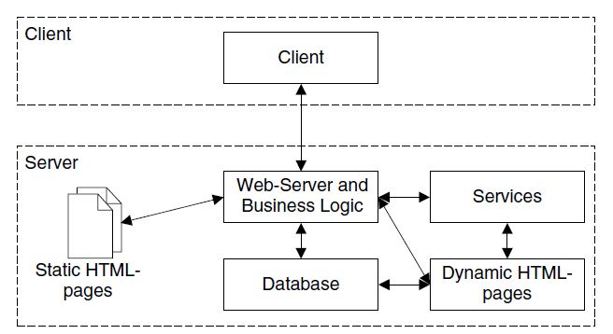
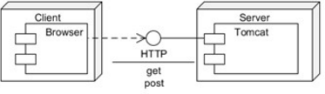
High Level Architecture
Architecture Layout Cont’d
Client-Server Architecture Diagram Samples

Slide 16
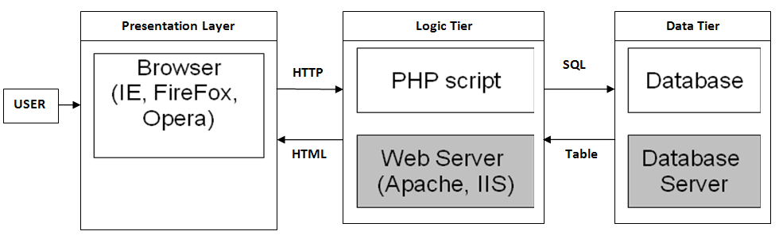
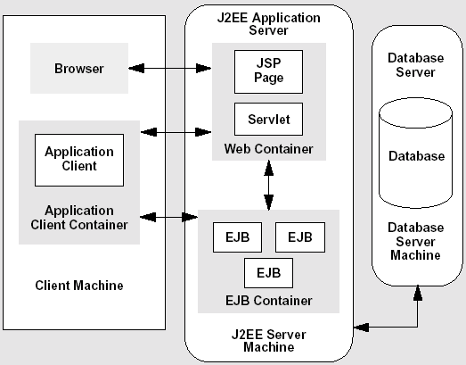
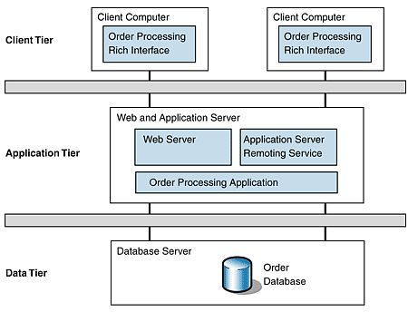
High Level Architecture
Architecture Layout Cont’d
3-Tier Architecture Diagram Samples

Slide 17
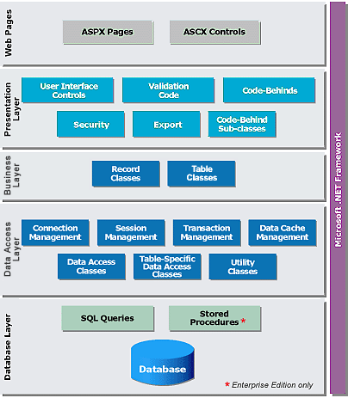
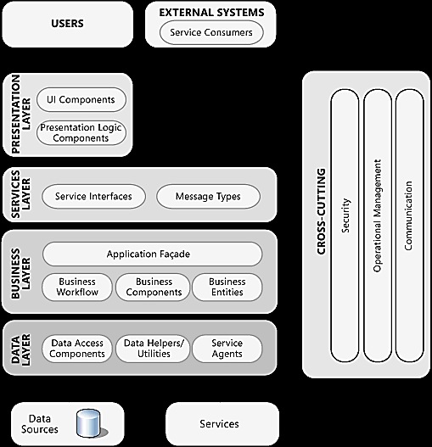
High Level Architecture
Architecture Layout Cont’d
4-Tier Architecture Diagram Samples

Slide 18
High Level Architecture
Defining Architecture Components
Architecture components are reusable concepts that are documented and ready for reapplication. The following puts the term into context:
Client-Based Components
Graphical interface classes and widgets for user interactions
E.g. Motif, Swing, Java Beans
Implementation Components
Language libraries used for implementing a design, using a programming language
E.g. JDK, middleware wrappers, code generators and repositories
Infrastructure Components
Processes built for a particular middleware architecture that can be customised for a specific task, implemented through service and servant modelling tools
E.g. CORBA, EJB, and TUXEDO

Slide 19
Component-based Design
Introduction
Component-based design encapsulates functionality at different layers or levels.
It is effort conserving, re-use enabling, and easy to enhance.
Functionalities or services that are common and repeated can be handled by Re-useable components.
The descriptions of the components should be hierarchically laid out .

Slide 20
Component-based Design
Detailed Description of System Components
The following aspects of each component should be stated:
n.x Component identifier:
Link component with any unique identifier (e.g. x can be 1, 2, 3, or C1, C2, C3, etc.)
n.x.1 Type:
State if it is a method, class, package or file.
n.x.2 Purpose:
A definite purpose that is traced to the requirements addressed by the component.
n.x.3 Function:
A short description of what component does in relation to the component type. E.g. the data to be stored
n.x.4 Subordinates (if applicable)
A list of modules “called by” the component.
The number 'n' should relate to the place of the component in the hierarchy.

Slide 21
Component-based Design
Detailed Description of System Components
n.x.5 Dependencies
A list of existing constraints for using the components.
E.g. pre-condition operations and post-condition operations.
n.x.6 Interfaces
e.g. method calls, parameter types, return data types, interrupts (if they exist).
n.x.7 Resources
Examples of resources that might be needed by a component are displays, printers and buffers
n.x.8 References (if applicable)
n.x.9 Processing (if applicable)
Known algorithms or flow construct to be used by component should be stated. Pseudo codes MAY also be stated
n.x.10 Data
This depends largely on the component type. For data structures, each element should be described (name, type, dimension; acceptable range of values of each element; initial values).

Slide 22
UML Component Diagram
What is a UML Component diagram?
UML Component diagrams are used to depict the organization and relationships among components in a system. They describe the building blocks used to make the system.
They are developed to visualize the implementation details, and are used during the implementation phase.
A component’s internals are hidden, but it has one or more well-defined provided interfaces (through which its functions can be accessed) as well as required interfaces (which defines what functions or services it requires from other components)

Slide 23
UML Component Diagram
Why use a Component diagram
Component diagrams model and document a system's high-level architecture. Hence, developers find it helpful for system comprehension.
Developers use the Component diagram to start to picture a roadmap for implementation
You may use a component diagram to represent your design irrespective of design platform or implementation language

Slide 24
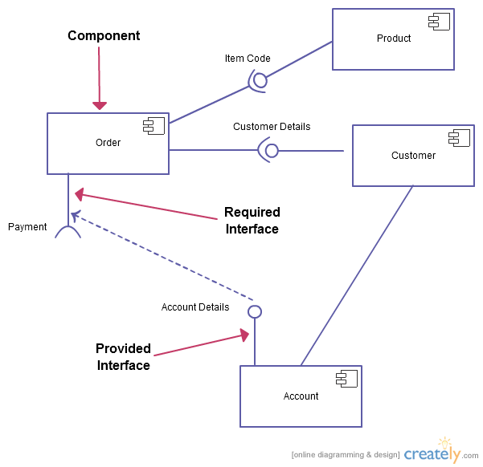
UML Component Diagram
Sample Component diagram

Slide 25
UML – Component Diagrams
Guidelines:
Identify all the system’s internal component
Give each component a unique name
For each component, identify if its requiring and/or providing an interface
Draw out all the components and Describe the organization and relationships between components using interfaces, ports, and dependencies
An interface is a unified collection of one or more methods, and zero or more attributes
Indicate each component’s required and/or provider interface

Slide 26
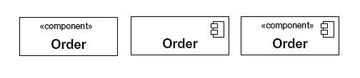
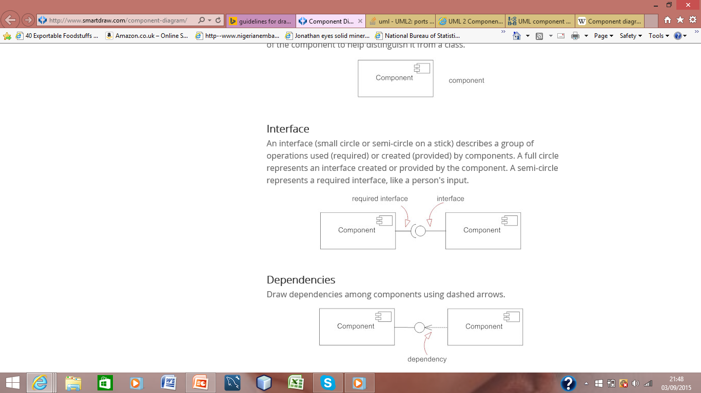
UML – Component Diagrams
Guidelines:
Different ways to represent a component
A full circle for an interface provided by the component
A semi-circle represents a required interface
Draw dependencies among components using dashed arrows
Note: you can use Microsoft visual studio to draw component diagram

Slide 27
UML – Component Diagrams
<<components>>
Payment
Processing
Total
Amount
C
Total
Amount
C
<<components>>
Customer
<<components>>
Product
<<components>>
Shopping Cart
Product details
C

